Slide 1

Vel Tech Rangarajan Dr. Sagunthala R&D Institute of Science and Technology
School of Computing
Department of Computer Science and Engineering
10211CS224 / FULL STACK APPLICATION DEVELOPMENT (JAVA)
PROJECT REVIEW : MILESTONE PROJECT – 1
Date: 04-03-2026
Dynamic Online Examination & Result Processing System
SDG: SDG No – SDG Title(Example: SDG 4 – Quality Education)
Presented By:
Ch.Venkata Susmitha – VTU26480 – Reg.No.23UECS0135
Courses Handling Faculty:
Dr.M.Mageshwari

Slide 2
INTRODUCTION
1
Traditional examination systems are time-consuming, paper-based, and prone to human errors in evaluation and result processing.
Manual correction and result preparation require significant effort and delay the announcement of results.
There is a need for an automated system that conducts exams efficiently and evaluates answers instantly.
The Dynamic Online Examination & Result Processing System addresses these issues using web-based technology.
This project is important because it reduces paperwork, saves time, and ensures accurate result calculation.
It is highly relevant in real-world scenarios such as schools, colleges, competitive exams, and recruitment tests.
The system allows student login, online test participation, automatic score calculation, and answer review.
Overall, it provides a secure, efficient, and user-friendly digital examination platform.
2
3
4
5
6
7
8
9

Slide 3
PROBLEM STATEMENT
1
Problem Statement:
Dynamic Online Examination & Result Processing System:
In many educational institutions, examinations are still conducted and evaluated manually.
Manual paper correction consumes time and increases the chances of human error.
Preparing results, calculating marks, and analyzing performance require significant effort.
Traditional systems also lack instant feedback for students.
Managing large numbers of students and question papers becomes difficult and inefficient.
There is a need for a secure and automated examination system.
The system should conduct exams, evaluate answers instantly, and generate accurate results.
Therefore, a Dynamic Online Examination & Result Processing System is required to improve efficiency, speed, and accuracy.
2
3
4
5
6
7
8
9

Slide 4
OBJECTIVE(S)
1
To design and develop a Dynamic Online Examination System that enables secure student login, online test participation, and automatic result generation.
To implement an automated evaluation mechanism that calculates scores instantly and displays correct answers for performance analysis.
2
3
4
5
6
7
8
9

Slide 5
PROPOSED SYSTEM
1
The proposed system is a web-based Dynamic Online Examination & Result Processing System with secure student login.
It allows students to take exams online and submit answers digitally.
The system automatically evaluates responses and generates results instantly.
It eliminates manual paper correction, reducing time and human errors.
The system displays wrong answers along with correct answers for better understanding.
It improves efficiency by managing multiple students and questions digitally.
The solution ensures accuracy, faster result processing, and easy record maintenance.
Compared to traditional systems, it is cost-effective, time-saving, reliable, and user-friendly.
2
3
4
5
6
7
8
9

Slide 6
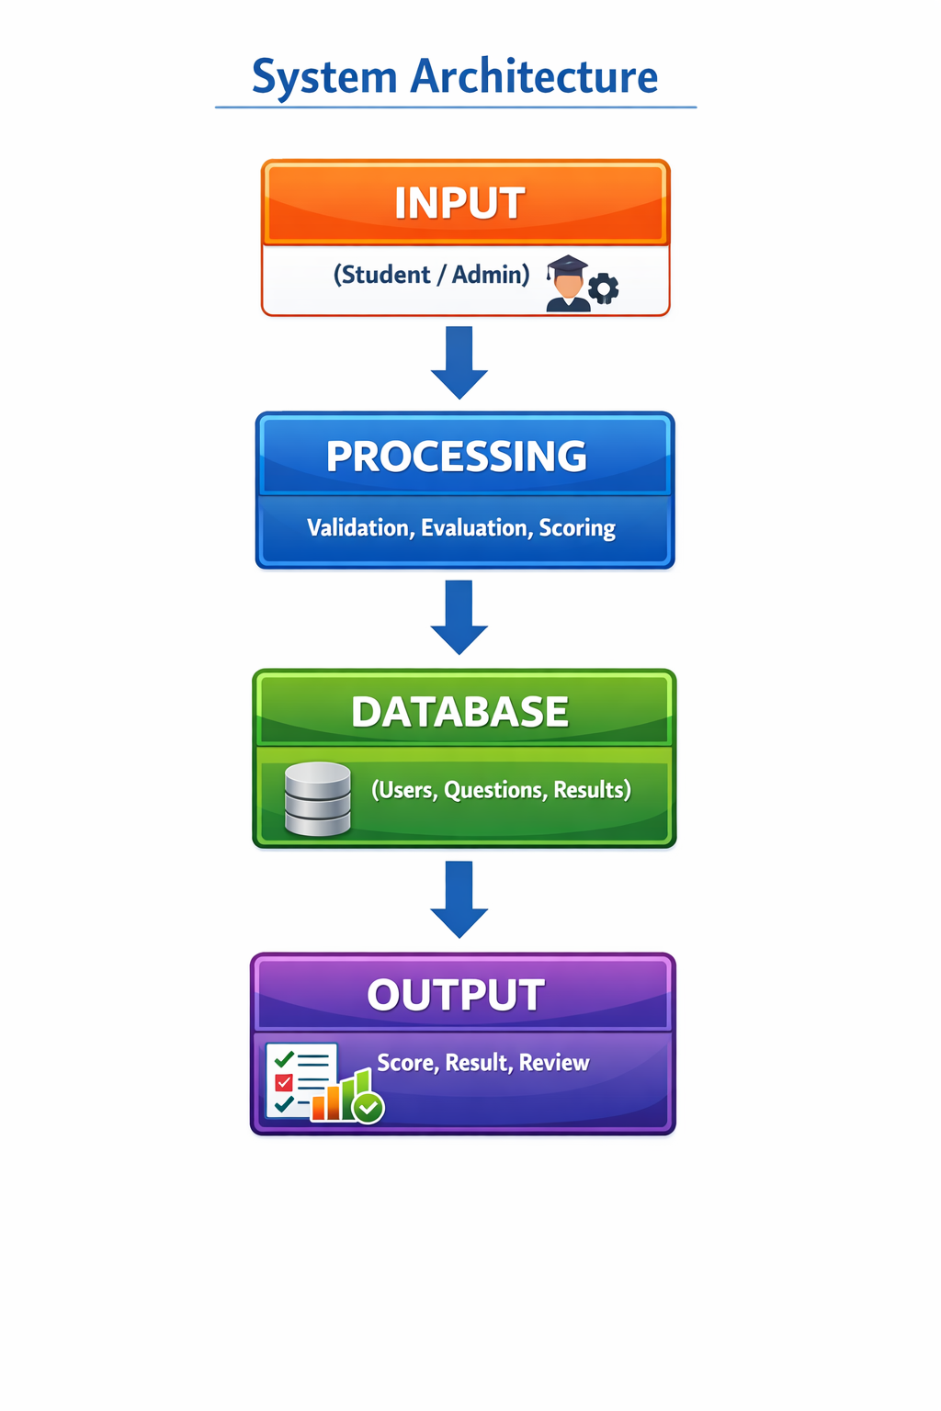
PROPOSED SYSTEM ARCHITECTURE
1
2
3
4
5
6
7
8
9

Slide 7
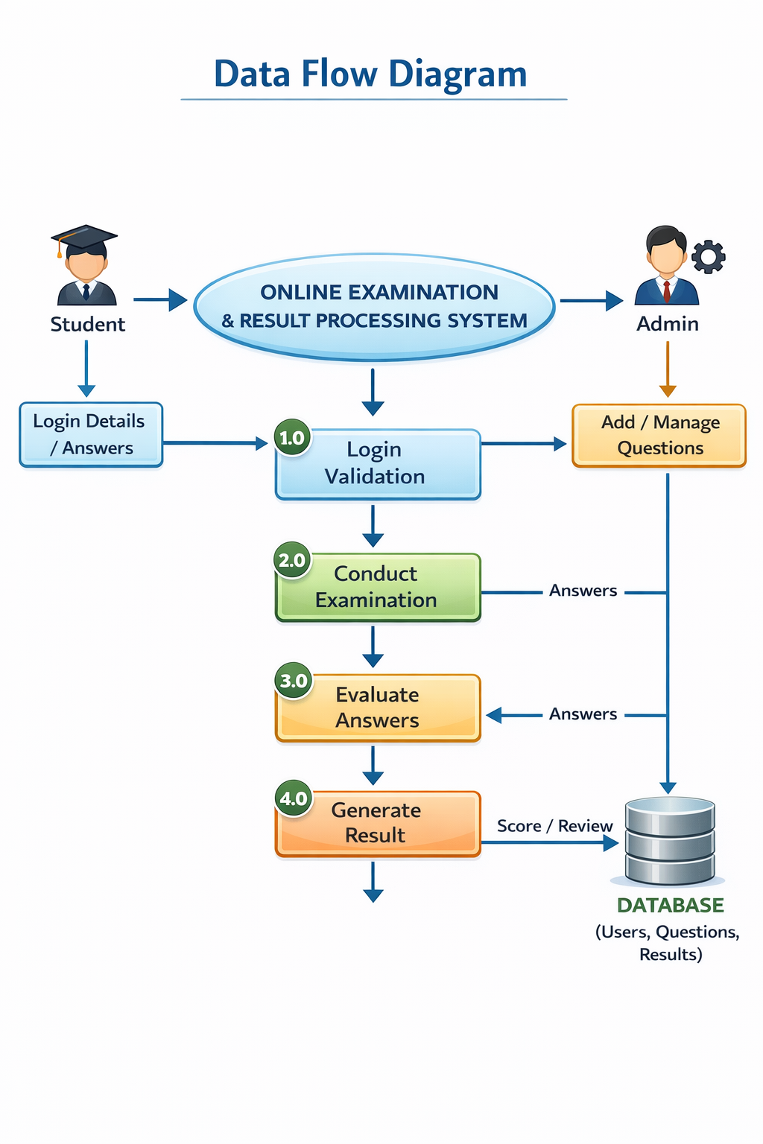
WORKFLOW
1
2
3
4
5
6
7
8
9

Slide 8
TECHNOLOGIES USED
Frontend:
HTML
CSS
JavaScript
Backend:
JavaScript (for login validation and automatic result evaluation)
(Advanced Version: Python – Flask / PHP)
Database:
Browser-based Storage (Arrays / Local Storage)
(Advanced Version: MySQL / SQLite)
Tools Used:
Notepad
Web Browser (Google Chrome)
Hardware Requirements:
Computer / Laptop
Minimum 4 GB RAM
Internet Connection (for online deployment version)
Software Requirements:
Windows, Web Browser
Text Editor (Notepad )
1
2
3
4
5
6
7
8
9

Slide 9
MODULE DESCRIPTION
1
Module 1: User Authentication & Login Management
Handles secure student login by validating username and password. Controls access to the examination system and ensures only authorized users can take the test.
Module 2: Examination Management
Displays multiple-choice questions dynamically and allows students to select and submit answers within the system interface.
Module 3: Evaluation & Result Processing
Automatically compares student answers with correct answers, calculates total score, identifies wrong/unattempted questions, and generates instant results.
Module 4: Data Management & Storage
Manages question bank, user credentials, and exam results using structured data storage to ensure accuracy and consistency.
2
3
4
5
6
7
8
9

Slide 10
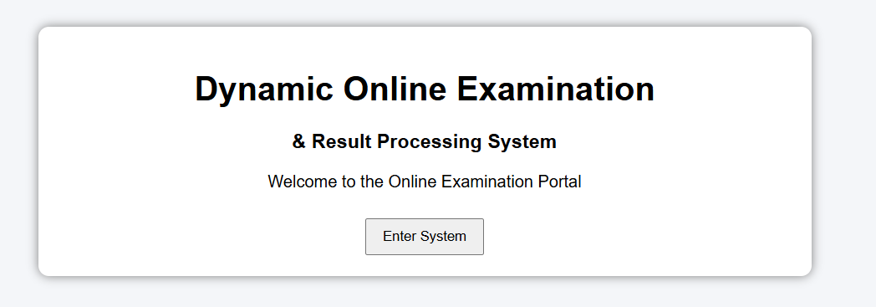
IMPLEMENTATION SCREENSHOTS
Home page: The Home Page serves as the welcome interface of the Dynamic Online Examination & Result Processing System. It displays the project title and provides an entry point to access the system. This page introduces users to the platform and ensures a simple navigation flow by directing them to the login page. It creates a user-friendly first impression of the system.
1
2
3
4
5
6
7
8
9

Slide 11

IMPLEMENTATION SCREENSHOTS
Login page: The Login Page allows students to securely access the examination system using valid credentials. It verifies the username and password before granting access to the exam. This ensures that only authorized users can participate in the examination. It acts as a basic authentication and security module of the system.
1
2
3
4
5
6
7
8(A)
9

Slide 12
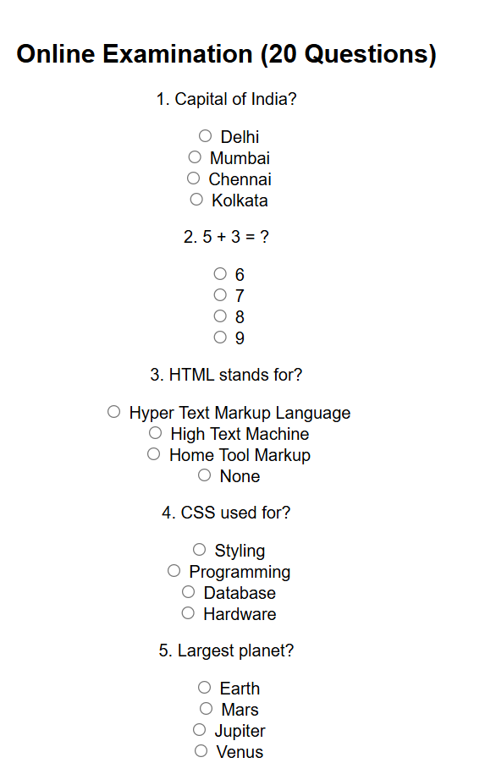
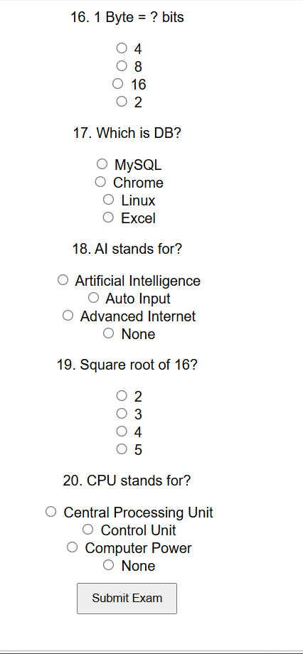
IMPLEMENTATION SCREENSHOTS
Main module: The Examination Page displays multiple-choice questions dynamically to the student. Users can select answers and submit the exam after completion. The system collects all selected responses and prepares them for automatic evaluation. This module handles the core functionality of conducting the online test.
1
2
3
4
5
6
7
8(B)
9

Slide 13
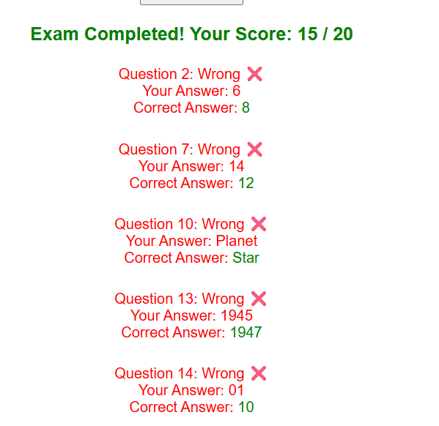
IMPLEMENTATION SCREENSHOTS
Output page: The Output Page displays the final score immediately after exam submission. It shows the total marks obtained and highlights wrong or unattempted questions along with correct answers. This provides instant feedback to students and improves transparency in evaluation. It ensures fast, accurate, and automated result processing.
1
2
3
4
5
6
7
8(C)
9

Slide 14
ADVANTAGES & LIMITATIONS
Advantages:
Provides instant and automatic result generation.
Reduces human errors in evaluation.
Saves time and paper compared to traditional exams.
Easy to use and user-friendly interface.
Displays correct answers for better student feedback.
Limitations:
Requires a computer or digital device to access.
Basic version does not store results permanently.
Limited security compared to advanced systems.
Depends on internet connection for online use.
Supports only objective-type (MCQ) questions.
1
2
3
4
5
6
7
8
9

Slide 15
Thank you

